Slide 1
IFB299
Release 2

Slide 2
Release 2 Features
Alter Event Information
Cancel Events
Call For Donations
Event Cost Shortfall – Ticket price
Event Donation Tracking
Total Donation Tracking
Create special events
Withdraw attendance
Check event fee
Check special event fees
Withdraw volunteering
View Donations Log

Slide 3
Release 2 Velocity
Velocity
Feature title | Story points
Feature 3 | 30
Feature 4 | 34
total | 64
Expected velocity | 32
Actual velocity | 32

Slide 4
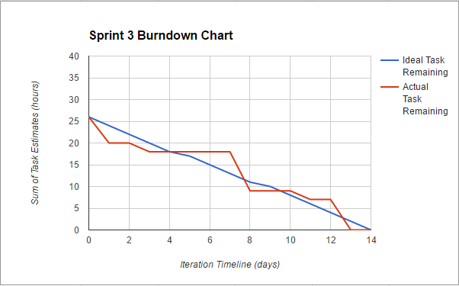
Sprint 3 Burndown

Slide 5
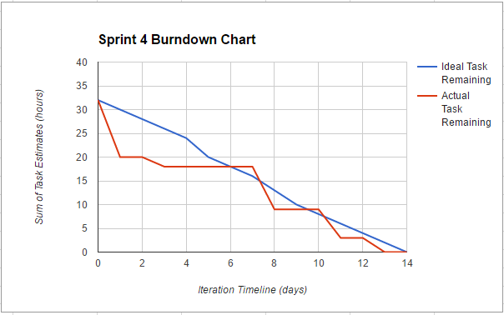
Sprint 4 Burndown

Slide 6
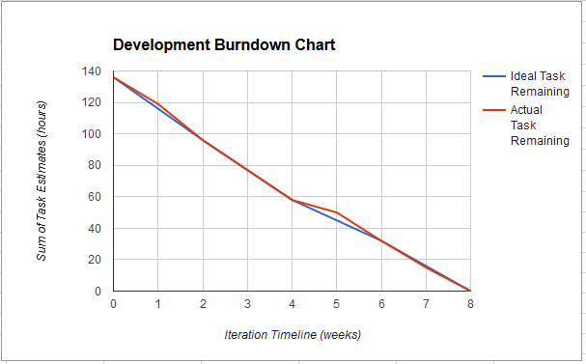
Development Burndown

Slide 7
Further development features
Events Fee Deadline
Recruit Volunteers
Select Volunteering Task
Deselect Volunteering Task
Social Media integration
View Volunteering Task
Edit Profile
History Log
Donor Donation tracking
View Donations Details

